Slide 1
OPERATIONS REVIEW
Warehouse Performance Dashboard
Logistics, fulfillment, and delivery metrics.

Slide 2

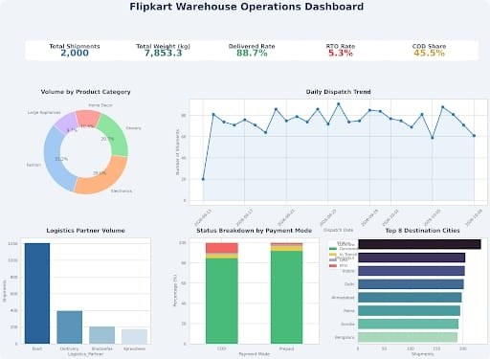
Source Dashboard Overview

Slide 3
Core Operational Metrics
2,000
88.7%
5.3%
Total Shipments
Delivered Rate
RTO Rate

Slide 4
PRODUCT VOLUME
Fashion
31.2%
Fashion & Electronics Lead Demand
Electronics
29.9%
Grocery
20.7%
Home Decor
10.9%
Combined 61% of total warehouse throughput.
Appliances
7.3%

Slide 5



Logistics Partner Utilization
Ecom handles massive majority of outbound volume.
Ecom
Delhivery
Others
~1,200
~400
< 350
Dominant carrier volume.
Secondary network partner.
BlueDart & XpressBees.

Slide 6
Prepaid Mode
Cash On Delivery (COD)
High Delivery Success
45.5% Volume Share
Dominant payment method.
Elevated RTO risk factor.
Negligible Return-to-Origin.
Requires strict address verification.

Slide 7

Primary Destination Hub
Lucknow leads incoming shipment volumes across top 8 national destinations.

